Slide 1
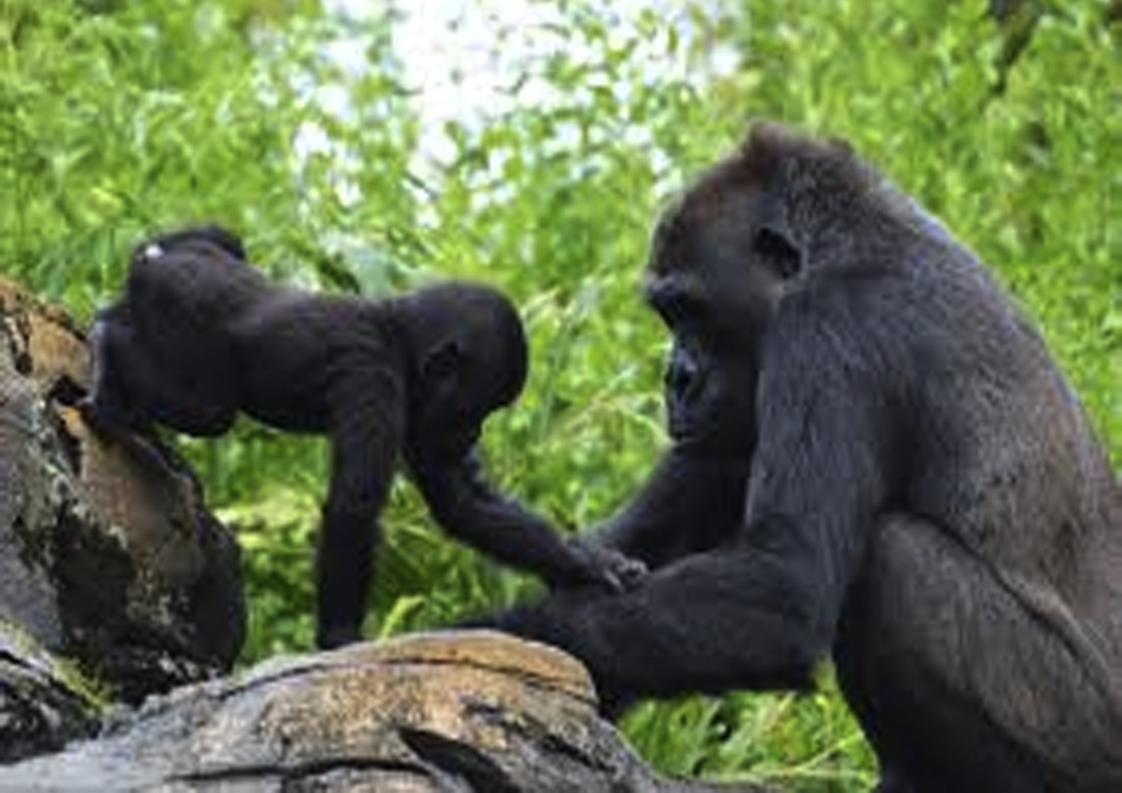
Your favourite emotion?
Your favourite way to feel to stop feeling sad?
Your favourite day of the week?
Your favourite school subject?
Your favourite to help others?
Your favourite way for some one to help you when your angry?
Your favourite zoo animal?
Your favourite hobby?
your favourite way to feel happy?
Your favourite cake?
Your favourite biscuit?
Your favourite place to relax?

